Slide 1
Meal Demand Forecasting
Group Members: Meeth Yogesh Handa, Saurabh Arora, Parthiv Borgohain, Rianna Patel, Rishabh Tiwari

Slide 2
Problem Statement
The goal of this project is to accurately forecast the demand for a meal delivery company in multiple cities, enabling their fulfillment centers to plan their raw material stock and staffing needs accordingly.
The project aims to develop a reliable demand forecasting model to help the company optimize their inventory management and staffing strategies, and ultimately improve customer satisfaction and profitability.

Slide 3
Business Relevance
Supply Decisions
- Safety stock reductions
- Production, transportation, and labor scheduling
Optimize
- Find the optimal balance between inventory and demand
Cost Savings
- Stricter operating cost control
- Packaging costs savings
Pricing
- Contribute to more precise product pricing
- Improve cash flow predictions
Customer Satisfaction
- Ensure production and delivery is completed on time

Slide 4
Data Sets
Data we need to provide forecast values for
Test set
Same fields as training data without response variable (num_orders)
Training set
Reports the demand for each fulfilment center
Id, week, center_id, meal_id, checkout_price, num_orders etc
Identifies each fulfilment center
Fulfilment Center Info
center_id, city_code, region_code, center_type, op_area
Meal Info
meal_id, category, cuisine
Identifies the meal being served

Slide 5
Methodology
Data Merging
EDA
1
2
Merge the data from the three Dataframes for further modeling
Exploratory Data Analysis to discover general trends present
Deploying Models
Feature Engineering
3
4
Use various machine learning models to predict future demand
Improve model performance by selecting/creating relevant features.

Slide 6
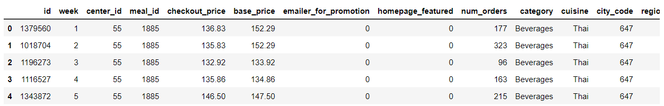
Merged Data Sets
Train data set
+
Meal Info
+
Fulfilment center info
Test data set
+
Meal Info
+
Fulfilment center info

Slide 7
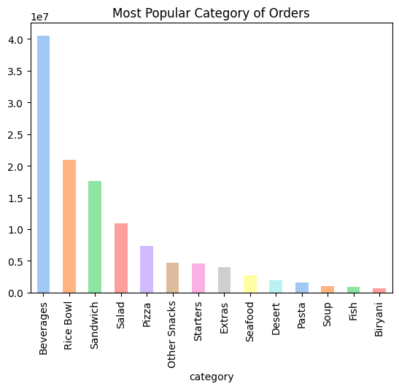
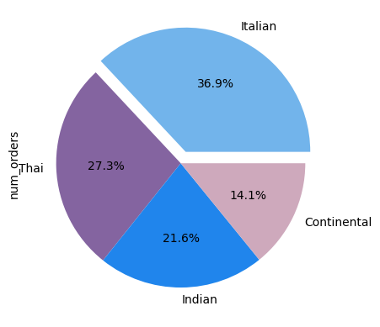
Exploratory Data Analysis

Slide 8
Proposed Models
For Forecasting Demand at the Fulfilment Centers
Decision Trees
1
2
Random Forests
Non-parametric approach to model demand and independent variables
Combination of decision trees to handle non-linear relationship
XGBoost
3
4
LightGBM
Gradient boosting algorithm that creates an ensemble of decision trees
Faster, memory-efficient gradient boosting algorithm

Slide 9
Proposed Models (contd.)
Regression-based Dynamic Demand Model
01
Purpose
Capture time-varying demand by using a regression model with a lagged week feature
02
Method
Use previous week's demand as predictor variable to forecast demand for upcoming week
03
Benefits
Improves accuracy of demand forecasting by adjusting to changes in demand over time;simple
04
Limitations
Assumes that demand patterns from the previous week are a good indicator of future demand patterns

Slide 10
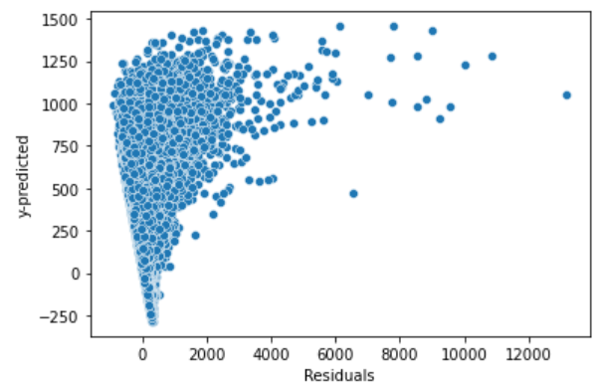
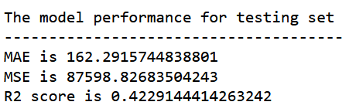
Baseline Models
Linear Regression
1
Ran a Basic Model
To establish baseline performance, we ran a simple linear regression without any feature engineering or tuning
2
Metrics
As shown on the right, we saw a modest performance of 0.42 R-Square score using this baseline model
3
Linear Regression Fit
As shown by the plot of Residuals vs Predicted values, this model does not seem to be a good fit for our data (systematic error)

Slide 11
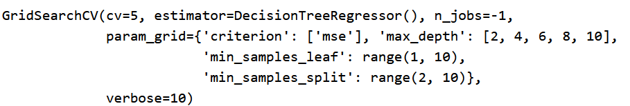
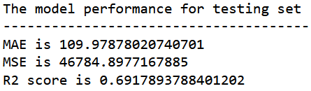
Baseline Models
2. Decision Trees
1
Ran a Basic Model
Ran a Decision Tree Model using GridSearchCV with 5-fold CV to find best fit decision tree
2
Metrics
As shown on the right, we saw a performance improvement to 0.69 R-Square score using the best tree model
3
Optimal Hyperarameters
Optimal fit was found for max_depth=10, min_samples_leaf=8

Slide 12
Anticipated Outcomes
Expected value addition after project completion
Improved Inventory Management
Better Procurement Planning
1
2
The meal delivery company will be able to stock the right amount of raw materials and reduce the risk of wastage.
The company can plan procurement more effectively based on accurate demand forecasts
Enhanced Staffing Decisions
3
4
Improved Customer Satisfaction
The company can ensure that they have the right number of staff to meet demand
The company can reduce out-of-stocks and ensure timely delivery, leading to better customer satisfaction
We expect the dynamic demand model and LightGBM to perform well in predicting demand, given their ability to capture time-varying demand and handle complex data.

Slide 13
THANK YOU!
Any Questions?

